Slide 1

MT-ComparEval for large-scale experiments and transfer learning
Anna Bardadym, Koen Van Winckel, Frederic Everaert, Joachim Van den Bogaert

Slide 2
MT-ComparEval

Slide 3
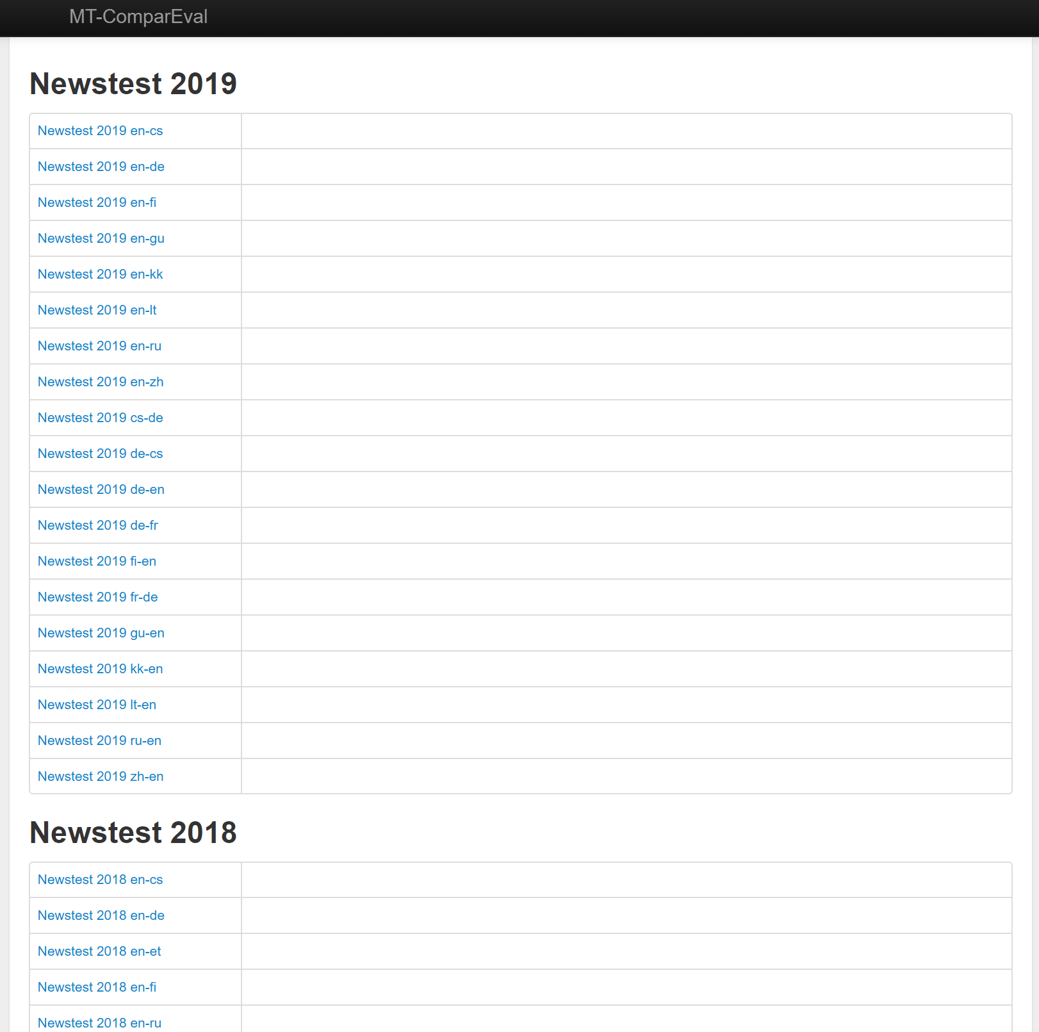
Developed by Ondrej Klejch (https://github.com/choko/MT-ComparEval)
Written in PHP, using the Nette framework
Tool for evaluating and comparing MT systems
Demo site with WMT 2014-2019 data: http://wmt.ufal.cz/
Overview with experiments

Slide 4
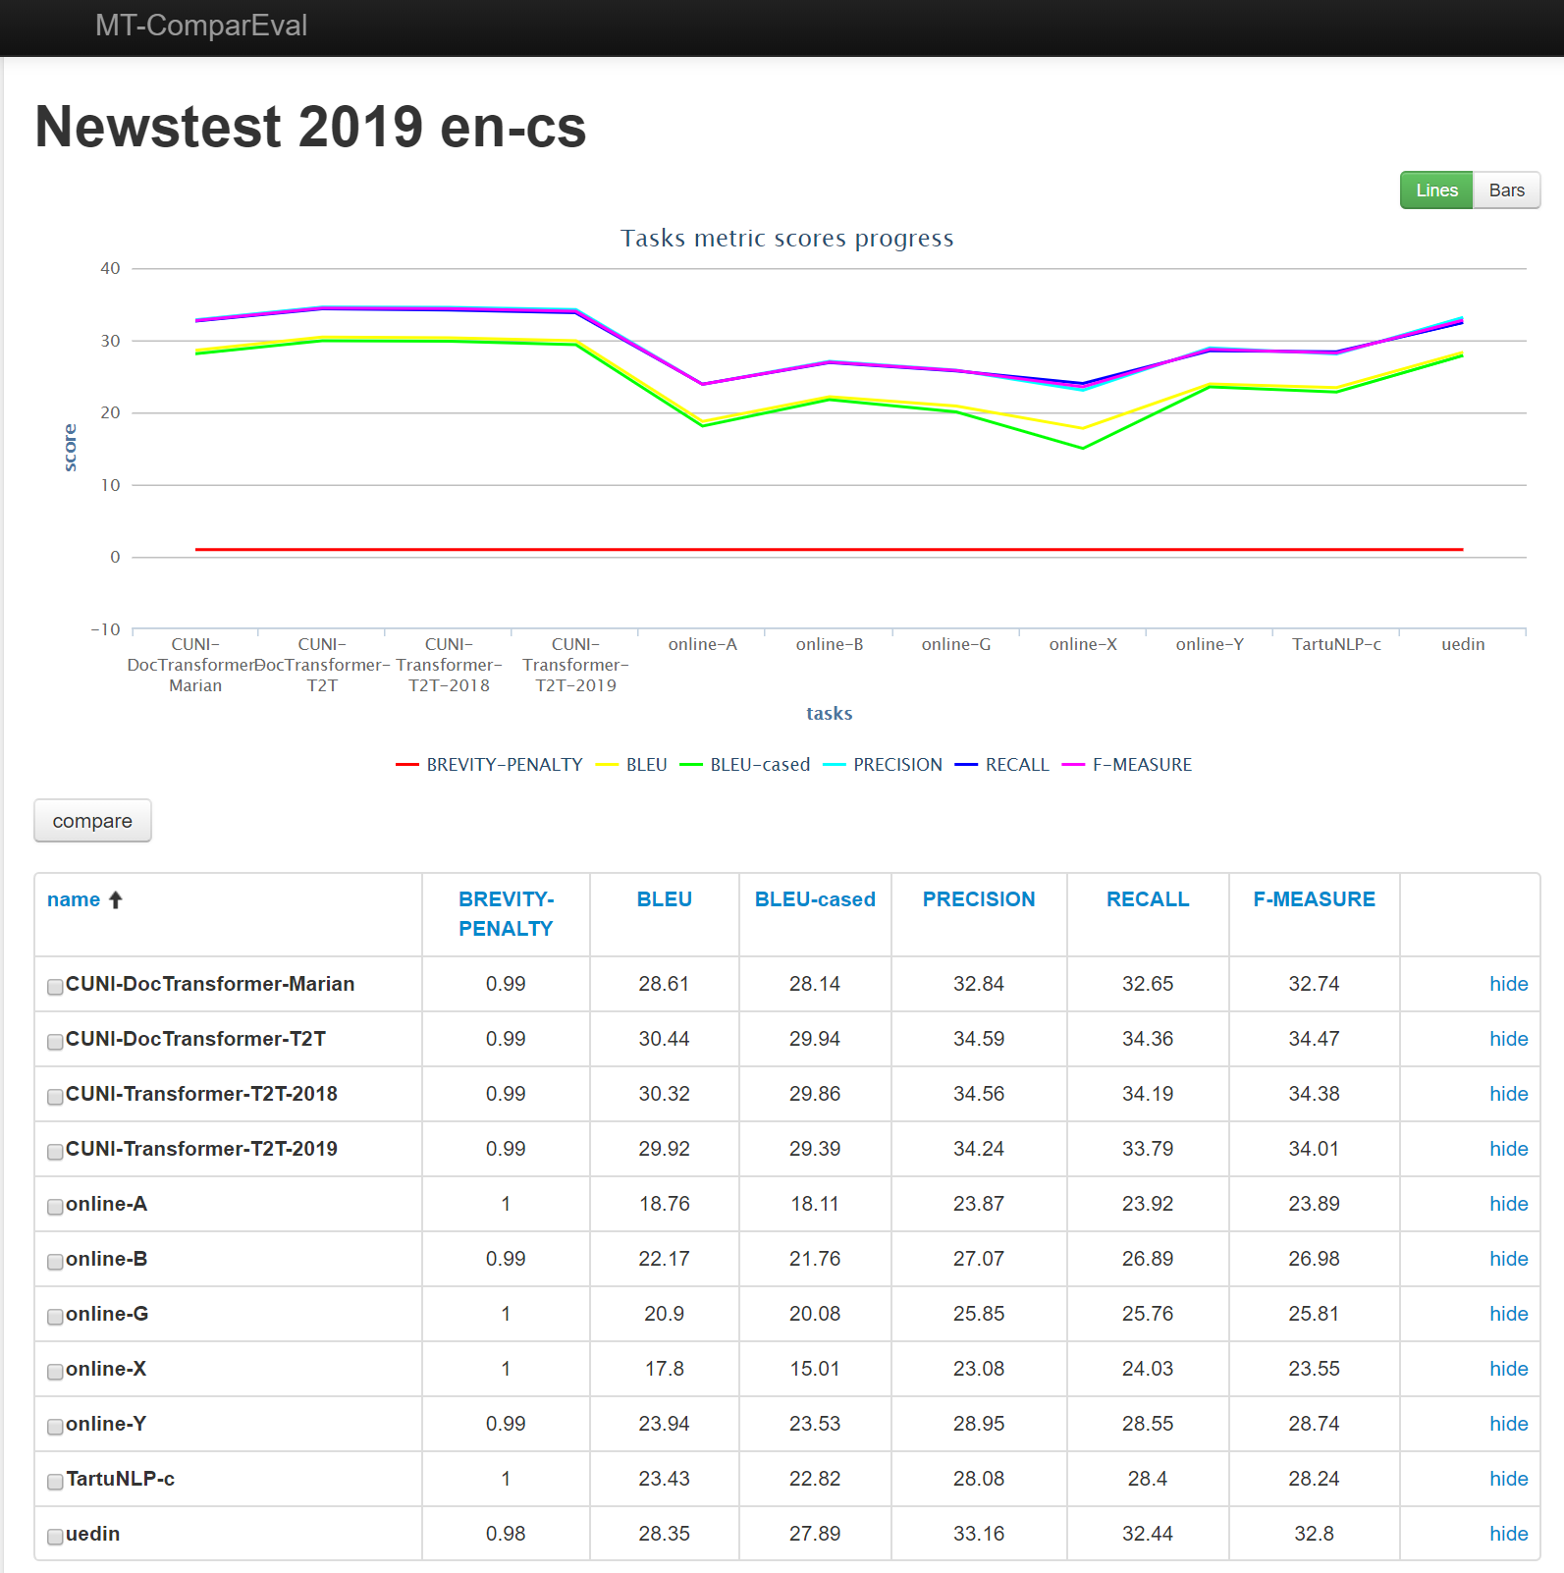
An experiment consists of several tasks
Each task shares the same source and reference
Translation differs for each task

Slide 5
Large-scale experiments

Slide 6
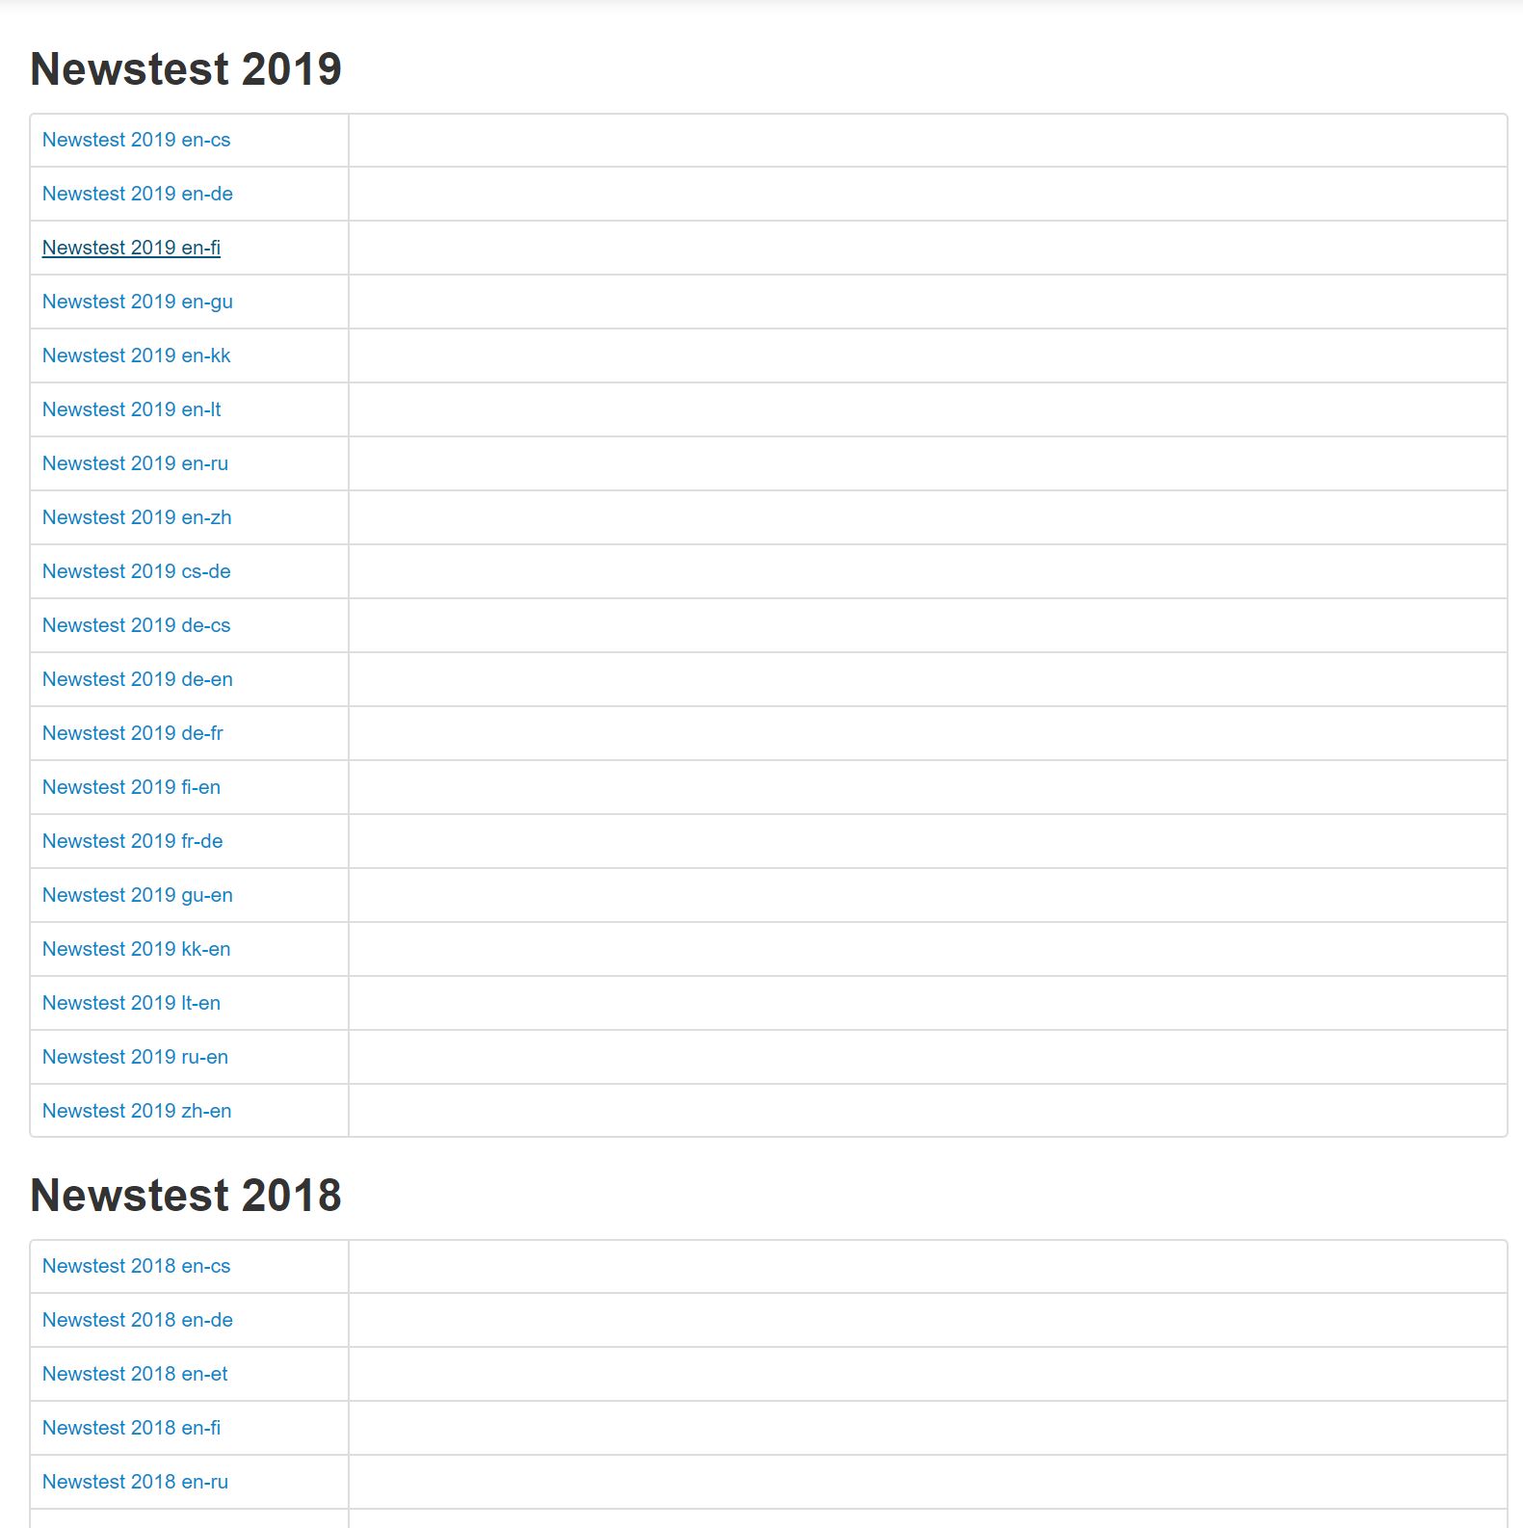

Slide 7
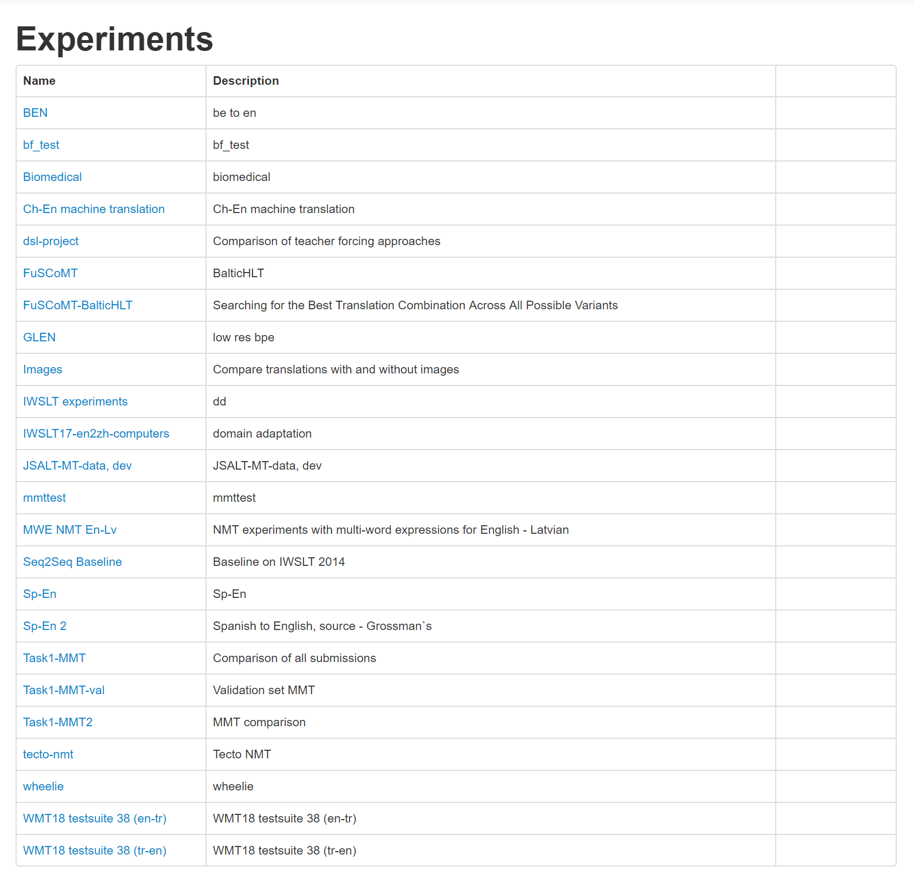

Slide 8
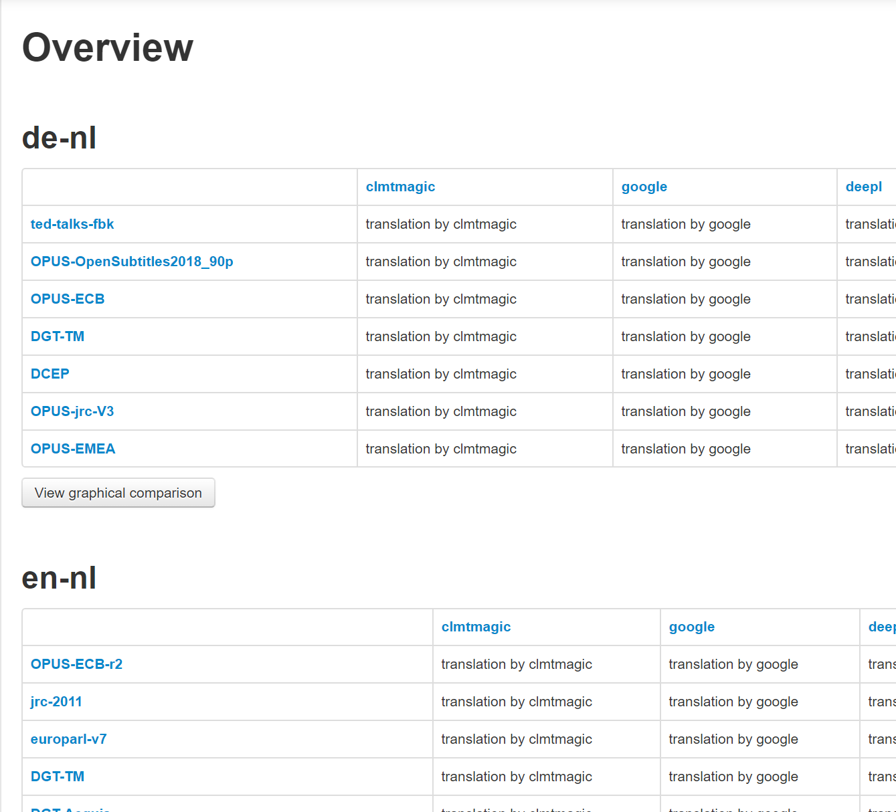
Additions and changes
Fork at https://github.com/CrossLangNV/MT-ComparEval
Experiments
Language pairs > Test sets > Engines > Tasks

Slide 9
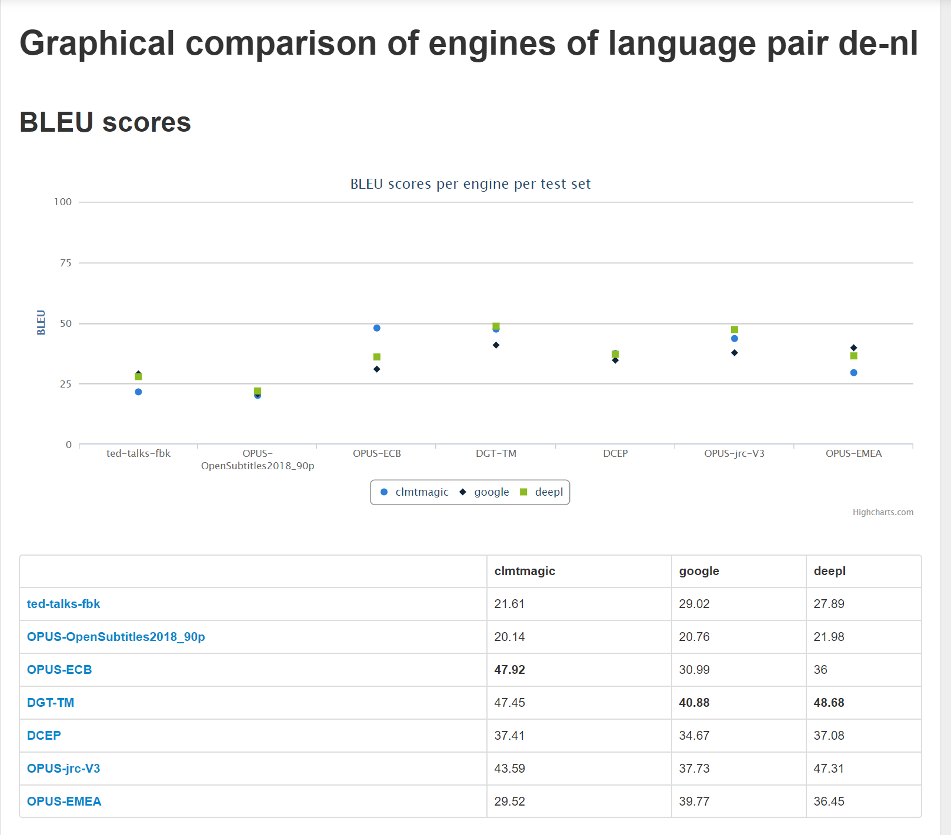
Graphical comparison per language pair

Slide 10
Delta view to compare all engines for a language pair to one selected engine

Slide 11
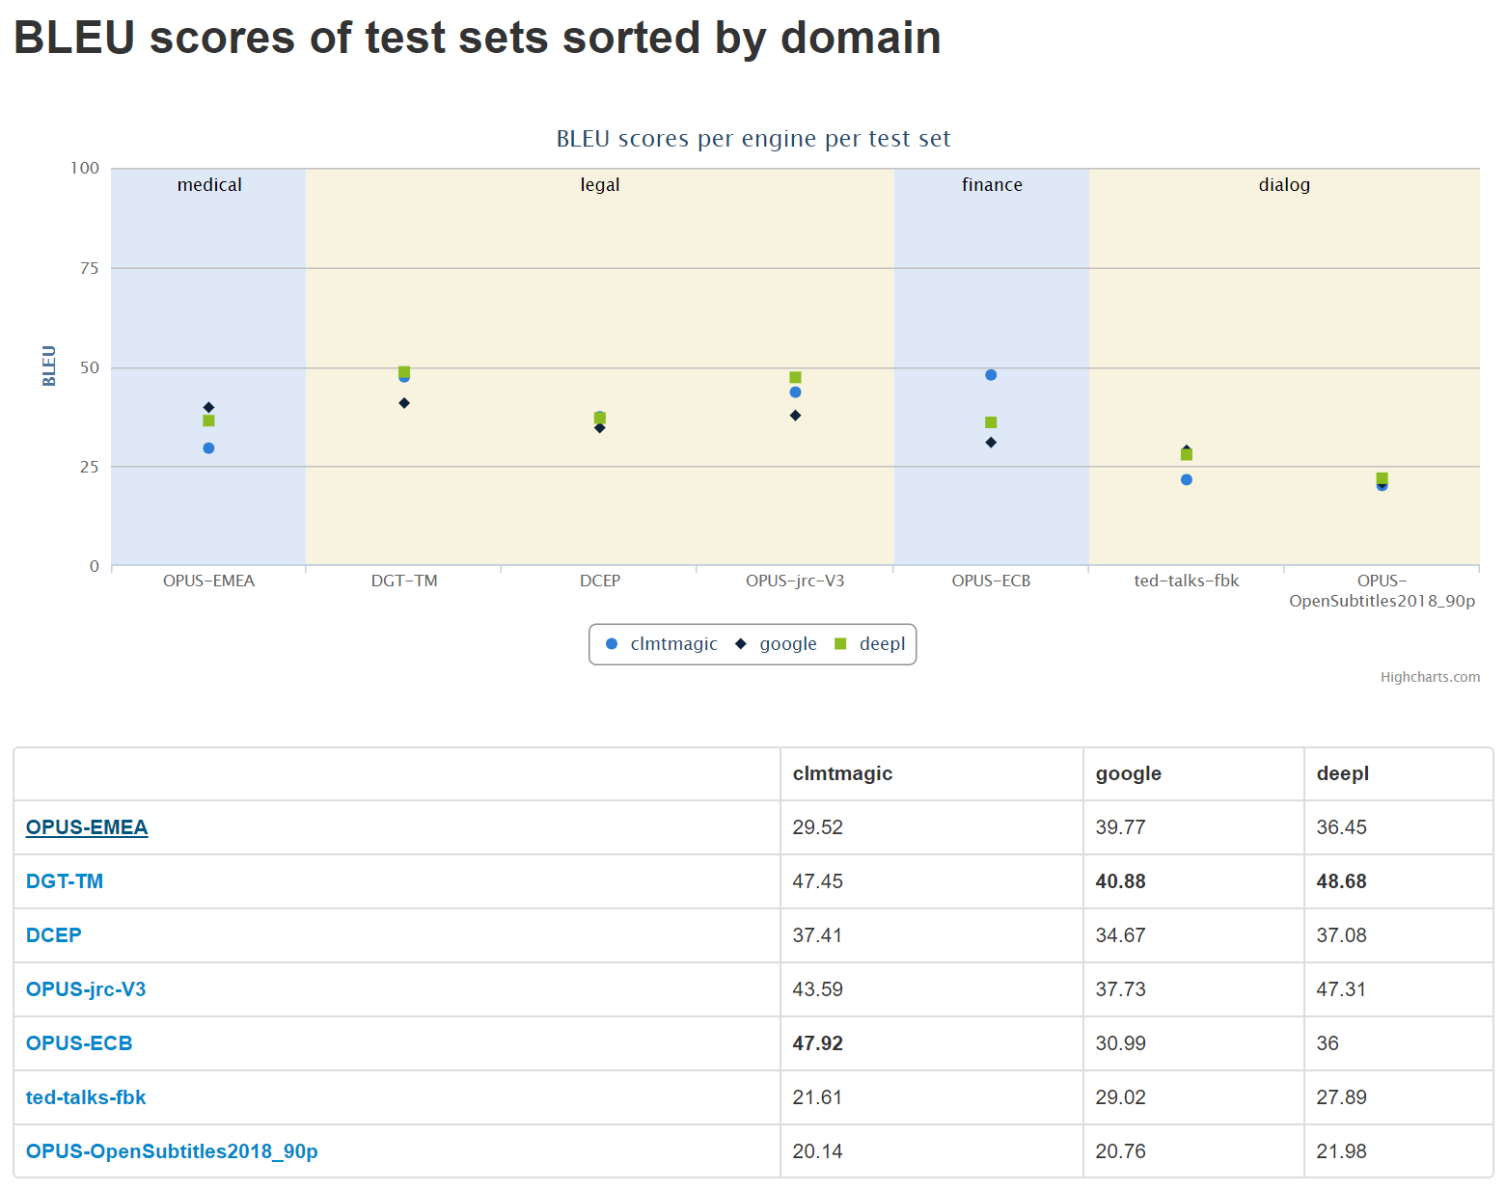

Slide 12
Transfer learning

Slide 13
Engine hierarchy
Specify parent for engine when creating a new one
Parent-child view
For all engines related to selected engine
For all engines

Slide 14
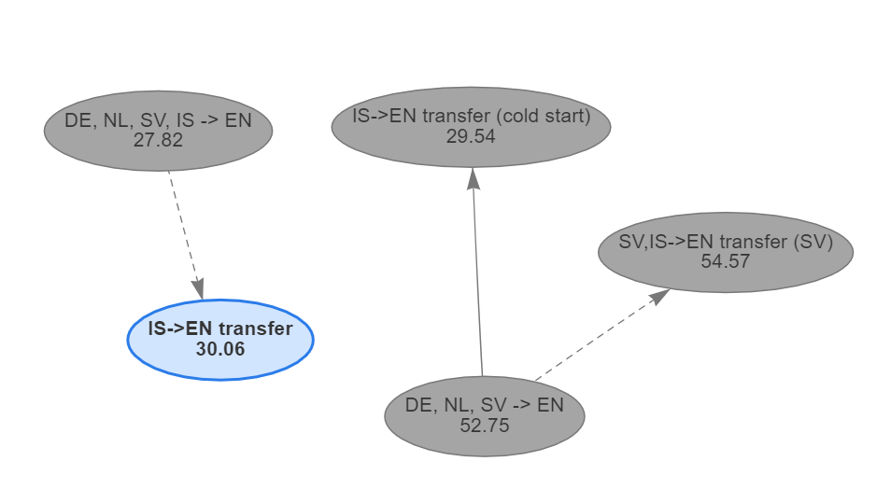
Engine hierarchy
Each node represents an engine
BLEU score calculated for all test sets translated with this engine
Arrow direction from parent to child
Dotted line when child outperforms parent, solid line otherwise

Slide 15
Demo and development work

Slide 16
Demo
See http://mtcompareval-ng.crosslang.com:8051

Slide 18
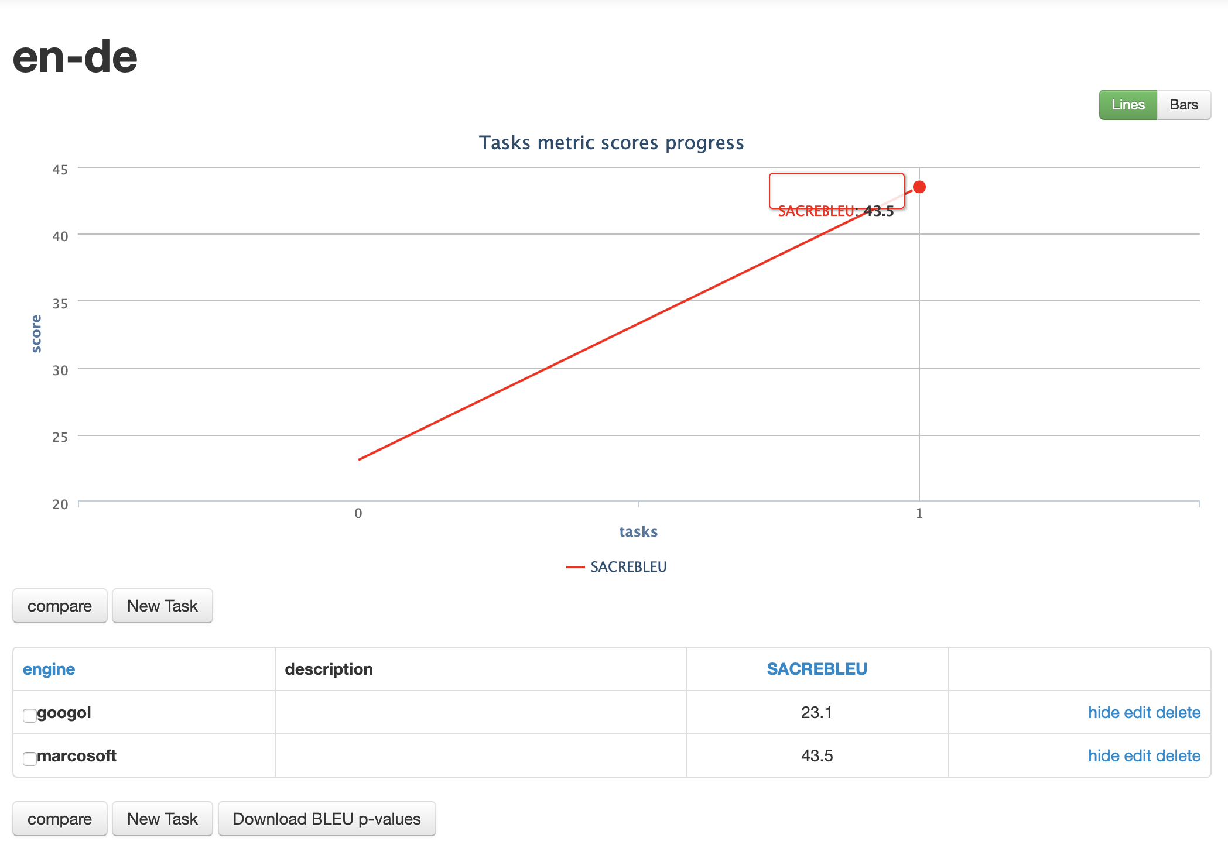
Work
UX
Global engine overview
Performance
Matrix overview
Import of tasks
SacreBLEU

Slide 19
Ongoing and future work
SQLite -> PostgreSQL migration
Bulk import functionality
Add more export possibilities
Post-editing information along with the sentences
Tables and figures to csv, LaTeX, pdf…
Multiple test set comparison
Measure how well an engine does for a domain
Add metric for significance of score
Comparisons are in BLEU, make it configurable for other metrics
Comparisons of subsets of test sets
Multi-user environment
Currently ongoing…
Currently ongoing…

Slide 20
Thanks!

